Slide 1
Public-Private Partnerships for Irrigation Development:
Results of the AMPPIDA project
Faustin Maganga
Presentation at Workshop on
Policy and Investment Options for
Irrigation Development in Tanzania
Tuesday,26 June 2018

Slide 2
Overview of PPPs for Irrigation
High cost of irrigation development but growing demand for ag income, stability
PPPs promoted by donors to mobilize resources from private sector: including financial, technical, and managerial resources
What is the evidence on what works for PPPs?
Irrigation PPPs more complicated than other PPPs

Slide 3
Overview of PPPs for Irrigation in Tanzania
PPPs as response to National Irrigation Master Plan and low level of “improved” irrigation compared to estimated potential (<1%)
Irrigation PPPs part of SAGCOT
Private sector seen as “a catalyst for new ideas and technologies so other farmers benefit from higher productivity and market access.”
Irrigation PPPs require more than irrigation: whole value chain

Slide 4
Case Studies
Case | Kilombero Plantation Limited (KPL) | Madibira Smallholder Agricultural Development Project | Kilombero Sugar
Crop | Rice, maize | Rice | Sugarcane
Size | 5818 ha (3,000 ha with irrigation) | 5,634 ha (3,000 with irrigation) | 12,000 ha
Modality | Irrigated core estate with unirrigated outgrowers | Farmer cooperative | Irrigated core estate with unirrigated outgrowers

Slide 5
Kilombero Plantations Ltd (rice scheme)
445, 986 ha of arable land
Fertile Kilombero valley, good for rice farming
Redevelop Mngeta Farm, joint venture betw North Korea and Tanzania started mid-1980s
2007 KPL PPP betw Rufiji Basin Development Authority (RUBADA) and Agrica (UK co, investors from Norfund, Capricorn Investment Group, and African Agricultural Capital) + DfID, USAID, JICA support
5818 ha estate; 1430 ha irrigated, 3000 by 2016
3200 outgrower farmers not irrigated but get SRI advice, link to inputs and microfinance

Slide 6
KPL Findings
Land tenure: Former state farm re-occupied, compensation to vacate, tensions with community
Price volatility: company and farmers losing out
Taxation policy on imported equipment
Multiple viewpoints, “realities”, blame game

Slide 7
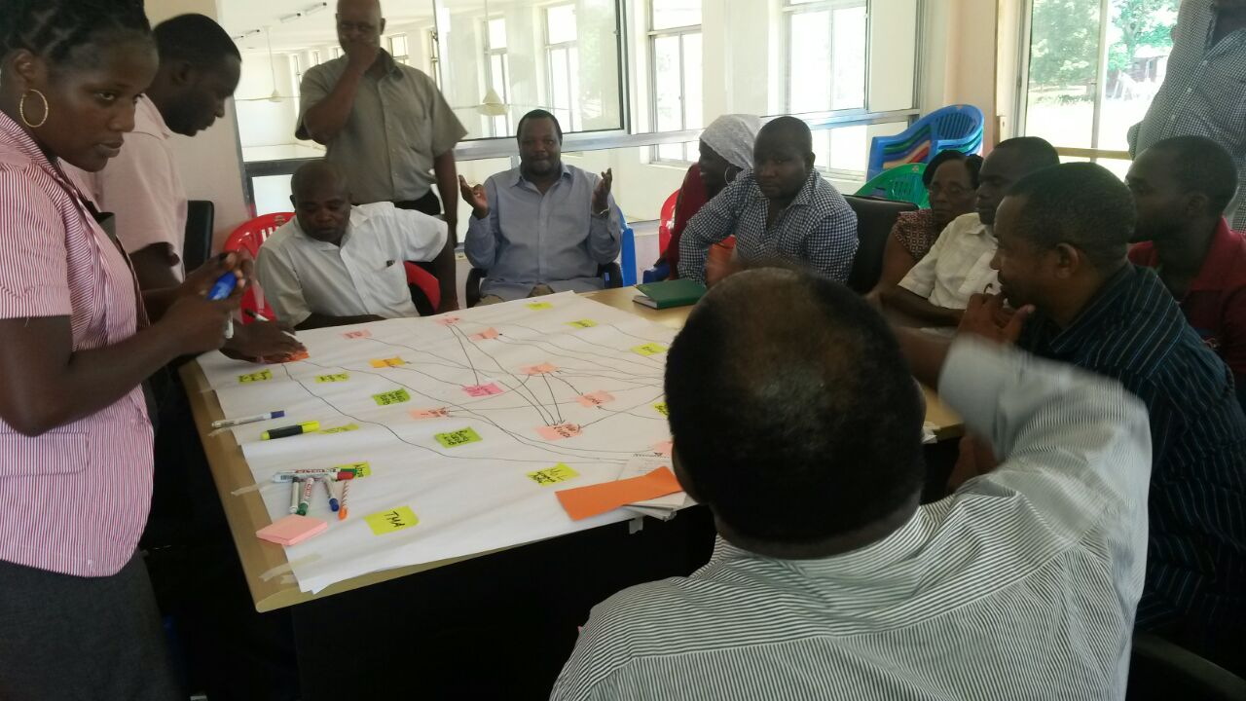
Netmapping
Overall:Who influences Public Private Partnership for Irrigation in xxx?
Links:
Technical advice
Funding
Inputs
Formal oversight
Political/ social
influences
Power/Influence:
How powerful is each actor over PPP in Irrigation Development in xxx?

Slide 8
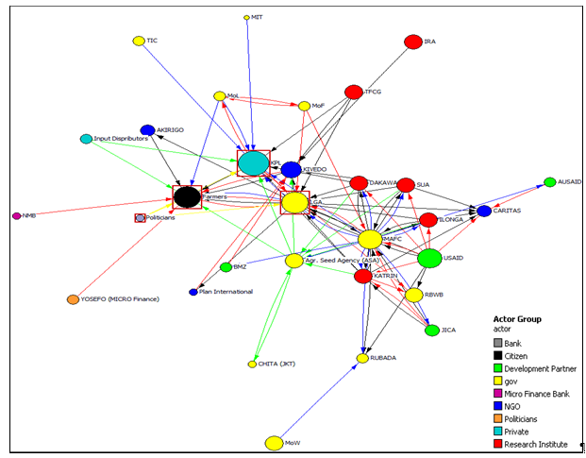
Kilombero Plantations Ltd Netmap
Notes:
Key things to note:
There are a LOT of different actors and types of actors involved, including donors, research institutes, financial institutions

Slide 9
KPL Funding Flows

Slide 10
KPL Regulation Network

Slide 11
KPL Technical Advice

Slide 12
Madibira Background
3000 ha rice irrigation farmer managed scheme established in the late 1990s
Constructed through a loan from the African Development Bank, and built on government land.
Owned and operated by the Madibira Agricultural Marketing Cooperative Society (MAMCOS).

Slide 13
Madibira Findings
Smallholders relatively satisfied
Scheme improved farmers’ income, housing and social services (health centers, primary and secondary schools)
Challenges:
Poor access roads
Rice milling plant shut down due to unreliable energy
Market unreliability
Shortage of equipment (tractors, power tillers)
Decrease of water for irrigation.

Slide 14
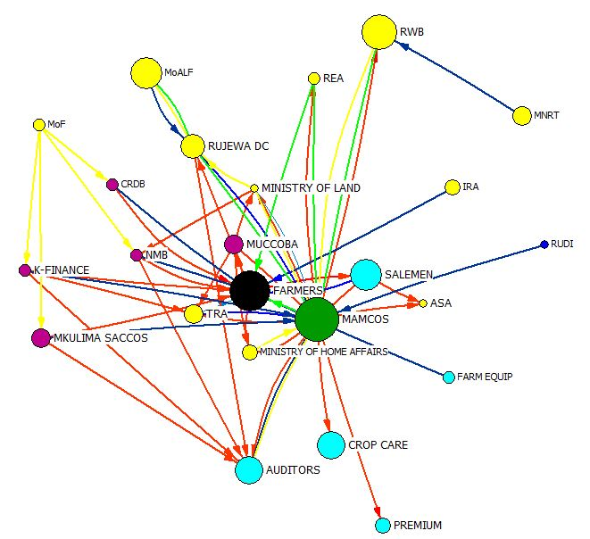
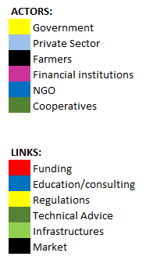
Madibira Net-Map
Legend:
Notes:
Compared to the other cases with one large central private sector, here you have several smaller private sector, and the central actors are the farmers and the farmer coop.
This is also the only one that did not identify donor or NGO involvement

Slide 15
Kilombero Sugar Background
Kilombero Sugar Company Limited - a registered sugar miller, grower and producer
KSCL owns estates 2: Msolwa estate (5000 ha), established in 1960 and production began in 1962, Ruembe (5000 ha), developed in 1974 and came into operation in 1976.
Divested in 1998 to Illovo Sugar Ltd and ED&F Man Ltd by selling 75 per cent of its shares The remaining 25 per cent is still held by GoT and will be sold, eventually, to Tanzanians, through the stock market.

Slide 16
Kilombero Sugar Findings
Sugar production has increased from 61,688 tons in 2000/01 to over 125, 374 tons in 2014/15. Mill expansions have allowed Out Growers to increase their production area from 3,855 ha in 1998/99 to about 12,000 ha in 2014/15.
A cane supply agreement has been introduced incorporating a division of proceeds formula for Outgrower cane payments.
Capable of exporting electricity to TANESCO
Maintains > 800 km of farm access roads

Slide 17
Kilombero Sugar Findings
Smallholder producer associations are important in linking the investors and smallholders
Associations provide essential agricultural services to their out-growers. Recently services expanded into cane harvesting, loan brokerage and administration, and extension support.
Associations enabled out-growers to negotiate and transact collectively with miller, reducing transaction costs to both parties. They also negotiate with CRDB Bank and National Microfinance Bank

Slide 18
Kilombero Sugar Findings
Challenges:
Transparency on measurement of weight of sugarcane for each farmer
Measurement of sucrose content which is done in closed laboratories of the nucleus farm
Governance issues related to operations of the famer associations

Slide 19
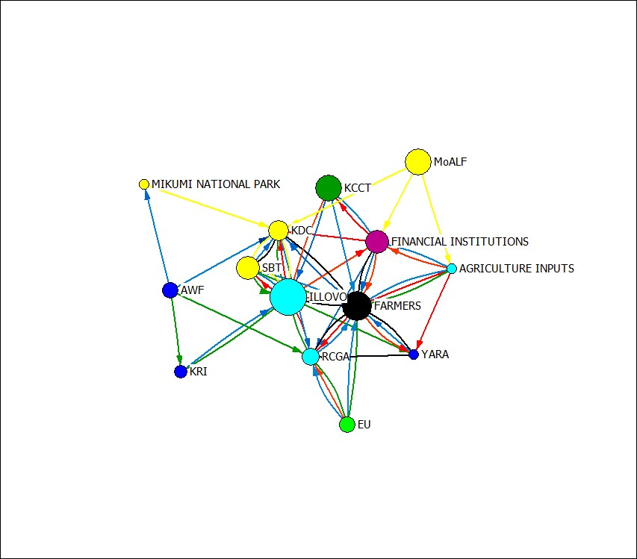
Kilombero Sugar Net-Map
Legend:
Notes:
Compared to other cases, this has fewer actors (sugarcane may be more centralized than rice)

Slide 20
Tanzania Conclusions
Few operating PPPs for irrigation
Low demand from investors to develop new areas
Hard enough to redevelop abandoned state farms
Land already (supposed to be) available
Only Madibira irrigates smallholder land
PPPs focus on core estates, technical assistance to outgrowers
Challenge to develop PPPP (Public Private Producer Partnerships)
Higher smallholder satisfaction on Madibira
More voice, accountability, irrigation service

Slide 21
Key Challenges Identified
Address formal and informal land and water rights to ensure legitimacy and prevent resentment
Need information on water availability and use (competing uses, climate change)
Production, Processing, and Price risks
Difficulty in aligning profit and development objectives
Time: Needed to build trust, but time/cost tradeoffs

Slide 22
Investment implications
Needs beyond irrigation infrastructure (technology, taxation, training, markets, inputs)
Who bears cost of supporting smallholder development?
Government?
Private companies?
Donors/Development partners?
Smallholders?
Institutional investment:
Smallholder coops/Associations play important role in Madibira, Kilombero Sugar
Recognize farmer associations as an investment

Slide 23
Comparative Structure
Activity | Govt | KPL | Farmers
Authorization
Planning | + Donors
Financing | +Donors, +MFI
System construction
System operation
System maintenance
On-farm construction
Technical advice
Production |  |  | Unirrigated
Processing
Marketing
Govt | MAMCOS | Farmers
ADB loan |  | Share capital
Notes:
We started with this generic framework to compare the different roles of government, private sector, and smallholders in the different cases.
However, when we did the Netmapping, we found a much more complex situation
There are many different agencies in “government”, many different private sector entities, and many other actors involved.
We also found that complexity was a source of problems

Slide 24
STAMP4 Irrigation: Stakeholder Task Alignment Matrix for Irrigation

Slide 25
Bagamoyo Sample
Activity | Task | Basin Water Authority | Ministry of Water | NIRC Natnl Irrig Commis | Ministry of Ariculture | TZ Fertilizer Authority | Tropical Pest Research Institute | SAGCOT | NEMC | Min. of Land | Sugar Board | TBS/TFDA | TIC | Dt Ag Research and Extension | TANESCO | TANAPA | Commissioner of Lands | LGA | Bagomoyo Sugar | Consultant | Contractor | Agro-chemical suppliers | Irrigators' Organization | Outgrowers | Other affected people | Village leaders | Farmers in villages | Bank | Microfinance Provider | Egyptian backer | AFDB | IFAD | Mlingano Research Institute | Kibaha Sugar Research Institute | NGO | Environment NGO
Feasability | Assessments: Enviro and Social | C |  | C |  |  |  |  | A |  |  |  |  |  |  | C |  | C | F, C | R |  |  | C |  |  | C | C |  |  | F
 | Soil and Water | C |  | C | C |  |  |  |  |  |  |  |  |  |  |  |  |  | F,C,A | R |  |  |  | C |  |  |  |  |  | F |  |  | C
Authorization | Land Rights (acquisition) |  |  |  |  |  |  |  |  | A |  |  | C |  |  |  |  | R |  |  |  |  | I |  |  | I | I
 | Water Usage Permits | A |  | C, I | C |  |  |  |  |  |  |  |  |  |  | C |  | R |  |  |  |  |  |  | C
 | Water Quality | A | R |  |  |  |  |  |  |  |  |  |  |  |  |  |  | C | C,I | R |  |  |  |  | C
Financing | Loan Contracts
Design | Headworks & nuclear farm |  |  | A |  |  |  |  |  |  |  |  |  |  | C |  |  |  | F | R
 | On-farm irrigation (outgrowers) |  |  | R, F |  |  |  |  |  |  |  |  |  |  |  |  |  | R |  |  |  |  | C |  |  |  |  |  |  |  |  |  |  | C
Construction | Land Clearing and Levelling |  |  |  |  |  |  |  |  |  |  |  |  |  |  |  |  |  | R
 | System construction |  |  |  |  |  |  |  |  |  |  |  |  |  |  |  |  |  | F |  | R
Operation | Capacity building for O&M
 | System operation |  |  |  |  |  |  |  |  |  |  |  |  |  |  |  |  |  | R
Maintenance | System maintenance (including drainage) |  |  |  |  |  |  |  |  |  |  |  |  |  |  |  |  |  | R
Monitoring | Water Use | R |  |  |  |  |  |  |  |  |  |  |  |  |  |  |  | C | C |  |  |  | C |  |  | C
 | Fee Collection | R |  |  |  |  |  |  |  |  |  |  |  |  |  |  |  |  | F
Technical Advice | Advice on irrigation practices |  |  | R |  |  |  |  |  |  |  |  |  |  |  |  |  |  | R | R
 | Advice on ag practices
Inputs | Seedlings |  |  |  | C |  |  |  |  |  |  |  |  |  |  |  |  |  | R |  |  |  |  |  |  |  |  |  |  |  |  |  |  | C,A
 | Fertilizer, Other agrochemicals |  |  |  |  | A | A |  |  |  |  |  |  |  |  |  |  |  | R
Production | Planting |  |  |  |  |  |  |  |  |  |  |  |  |  |  |  |  |  | R
 | Irrigating |  |  |  |  |  |  |  |  |  |  |  |  |  |  |  |  |  | R
 | Weeding |  |  |  |  |  |  |  |  |  |  |  |  |  |  |  |  |  | R
 | Harvesting |  |  |  |  |  |  |  |  |  |  |  |  |  |  |  |  |  | R
Processing | Product (processing/packaging) |  |  |  |  |  |  |  |  |  | A |  |  |  |  |  |  |  | R
 | Quality assurance |  |  |  |  |  |  |  |  |  |  | A |  |  |  |  |  |  | R
Marketing | Marketing produce |  |  |  |  |  |  |  |  |  | A |  |  |  |  |  |  |  | R
Construction | On-farm works (outgrowers)
Technical Advice (Outgrowers) | Advice on irrigation practices
 | Advice on ag practices (outgrow) |  |  |  | R |  |  |  |  |  |  |  |  | R |  |  |  | R | R |  |  |  |  |  |  |  |  |  |  |  |  |  | R | R
Financing Production (Outgrowers) | Financing inputs
Inputs (Outgrowers) | Seedlings
 | Fertilizer, Other agrochemicals
Production (Outgrowers) | Planting
 | Irrigating
 | Weeding
 | Harvesting
Processing (Outgrowers) | Product (processing/packaging)
 | Quality assurance
Marketing (Outgrowers) | Marketing produce

Slide 26
Implications
Sharing of costs, benefits, risks
Is irrigation likely to be profitable for investors? For smallholders?
Logic for state investment in irrigation as a public good, less for private sector.
“Beyond panaceas”
Need to engage with complexity
Tools for understanding complex arrangements
Range of options for “PPP” arrangements
Many “private sector” options; Smallhoders as investors?

