Slide 1

Preliminary assessment of farmer-led irrigation In Tanzania and Mozambique
Hans Komakech, NM-AIST, Arusha
and
Phil Woodhouse, University of Manchester
Workshop: “Policy and investment options for irrigation development in Tanzania” Tuesday, 26 June 2018, Dar es Salaam

Slide 2
Background

Slide 3
Changing Perspectives on African irrigation
1970s – 1980s investment for Africa’s ‘green revolution’
1990s disenchantment following critical reviews:
  inappropriate technical design (Adams,, Vincent and Diemer)
  High cost, low performance (Moris and Thom)
  Concern to design better to serve (small-scale) irrigators (Horst)
1990s – 2005 ‘lost decade’ for funding for irrigation and agriculture
2003 NEPAD:
  Comprehensive Africa Agricultural Development Programme (CAADP) ‘pillar 1’ calls for ‘reliable water control systems’
2007-8 food commodity price crisis
2010 – ‘land grab’: concessions of (irrigated?) agricultural land in Africa to foreign investors
2012 – formal irrigation increase has been slow (excl. sugarcane), but mounting evidence of ‘small-scale private’ irrigation (de Fraiture et al).
Notes:
CAADP extending the area under sustainable land management and reliable water control systems

Slide 4
Prior studies in Mozambique
(Wageningen University, the Netherlands)
2005-2008 study of mountainous areas on Mozambique and Zimbabwe – Revue-Buzi river basin (Bolding et al)
  Area of refuge for Mozambicans during 1980-1992 and following land reform in Zimbabwe 2002-5
  Identified 5-10,000 ha of furrow irrigation largely overlooked by Mozambican government
2010 World Bank-funded PROIRRI project (Beekman et al)
  surveys 7 districts in central Mozambique:
  Estimates 10,000 ha irrigated (government recognised 1208 ha in 2003).
2012-3 Messica Irrigation Pilot Project (Veldwisch et al):
  Doubled PROIRRI estimates of irrigated areas
  Suggests small-scale ‘informal’ irrigation may be 115,000 ha in Mozambique, compared to 118,000ha of ‘equipped’ irrigation areas (of which <50% in use)
The more closely you look, the more irrigation you find…..

Slide 5
Prior studies in Tanzania
Strong pre-colonial irrigation traditions in northern Tanzania: long-established canal systems (Stump et al., Adams)
Farmers’ irrigation of paddy rice from upper catchment of Great Ruaha: intake design and water allocation; variations according to annual water availability (Lankford, Franks, Cleaver)
‘traditional’ and ‘improved traditional’ irrigation: contemporary institutional development in Kilimanjaro and Same Mts (Komakech et al)

Slide 6
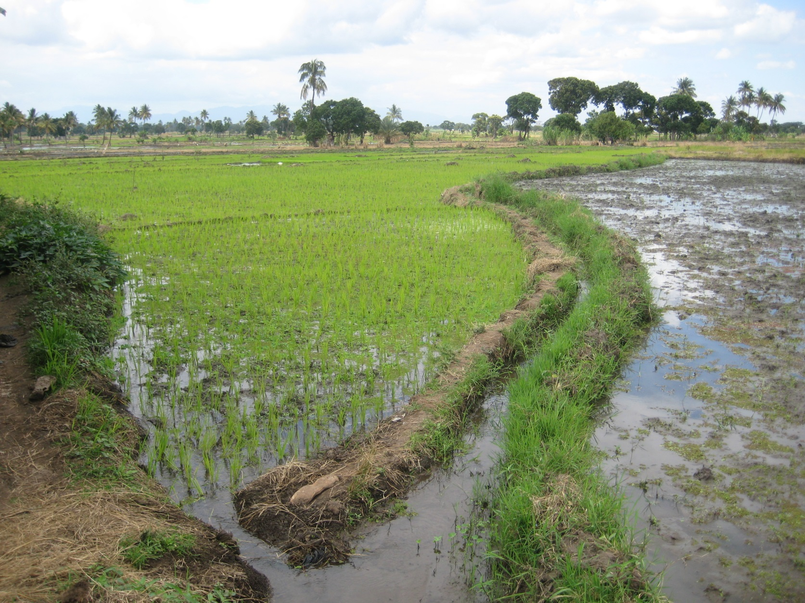

Slide 7
The SAFI project (2015-2018)
Response to UK DFID-ESRC Growth Research Programme (DEGRP) sub-theme: “What institutions and policies lead to investment in irrigation by individual farmers, groups of farmers and large-scale enterprises?”: Project title
“Assessing the growth potential of farmer-led irrigation development in sub-Saharan Africa.”
Partnership between African researchers (NM-AIST and ISPM) and European (Manchester and Wageningen, + Sheffield, IRD, Edinburgh)

Slide 8
SAFI project design
Two central questions:
What characterises small-scale farmers’ own initiatives in developing agricultural water management, and what social and economic changes are associated with them? And how are these socially differentiated (gender, age, ethnicity, etc.)?
What are the perceptions and responses of agricultural development agencies (government, donors, NGOs, commercial investors) to irrigation developed by small-scale farmers?
Can we get more accurate estimates of total extent of irrigated areas?

Slide 9
SAFI project methods
What are the characteristics and impacts of ‘farmer-led’ irrigation development
  Field studies of specific cases where farmers influence the purpose, location and design of irrigation.
How do development agencies and governments engage with farmers’ irrigation initiatives?
  National-level policy workshops with policy makers and technical advisors
  Review and analysis of policy documents and implementation.
  Interviews with policy makers, donors, practitioners and farmers
  Presentation and discussion of analysis with policy-makers.
More accurate measurements?
  analysis of satellite images

Slide 10
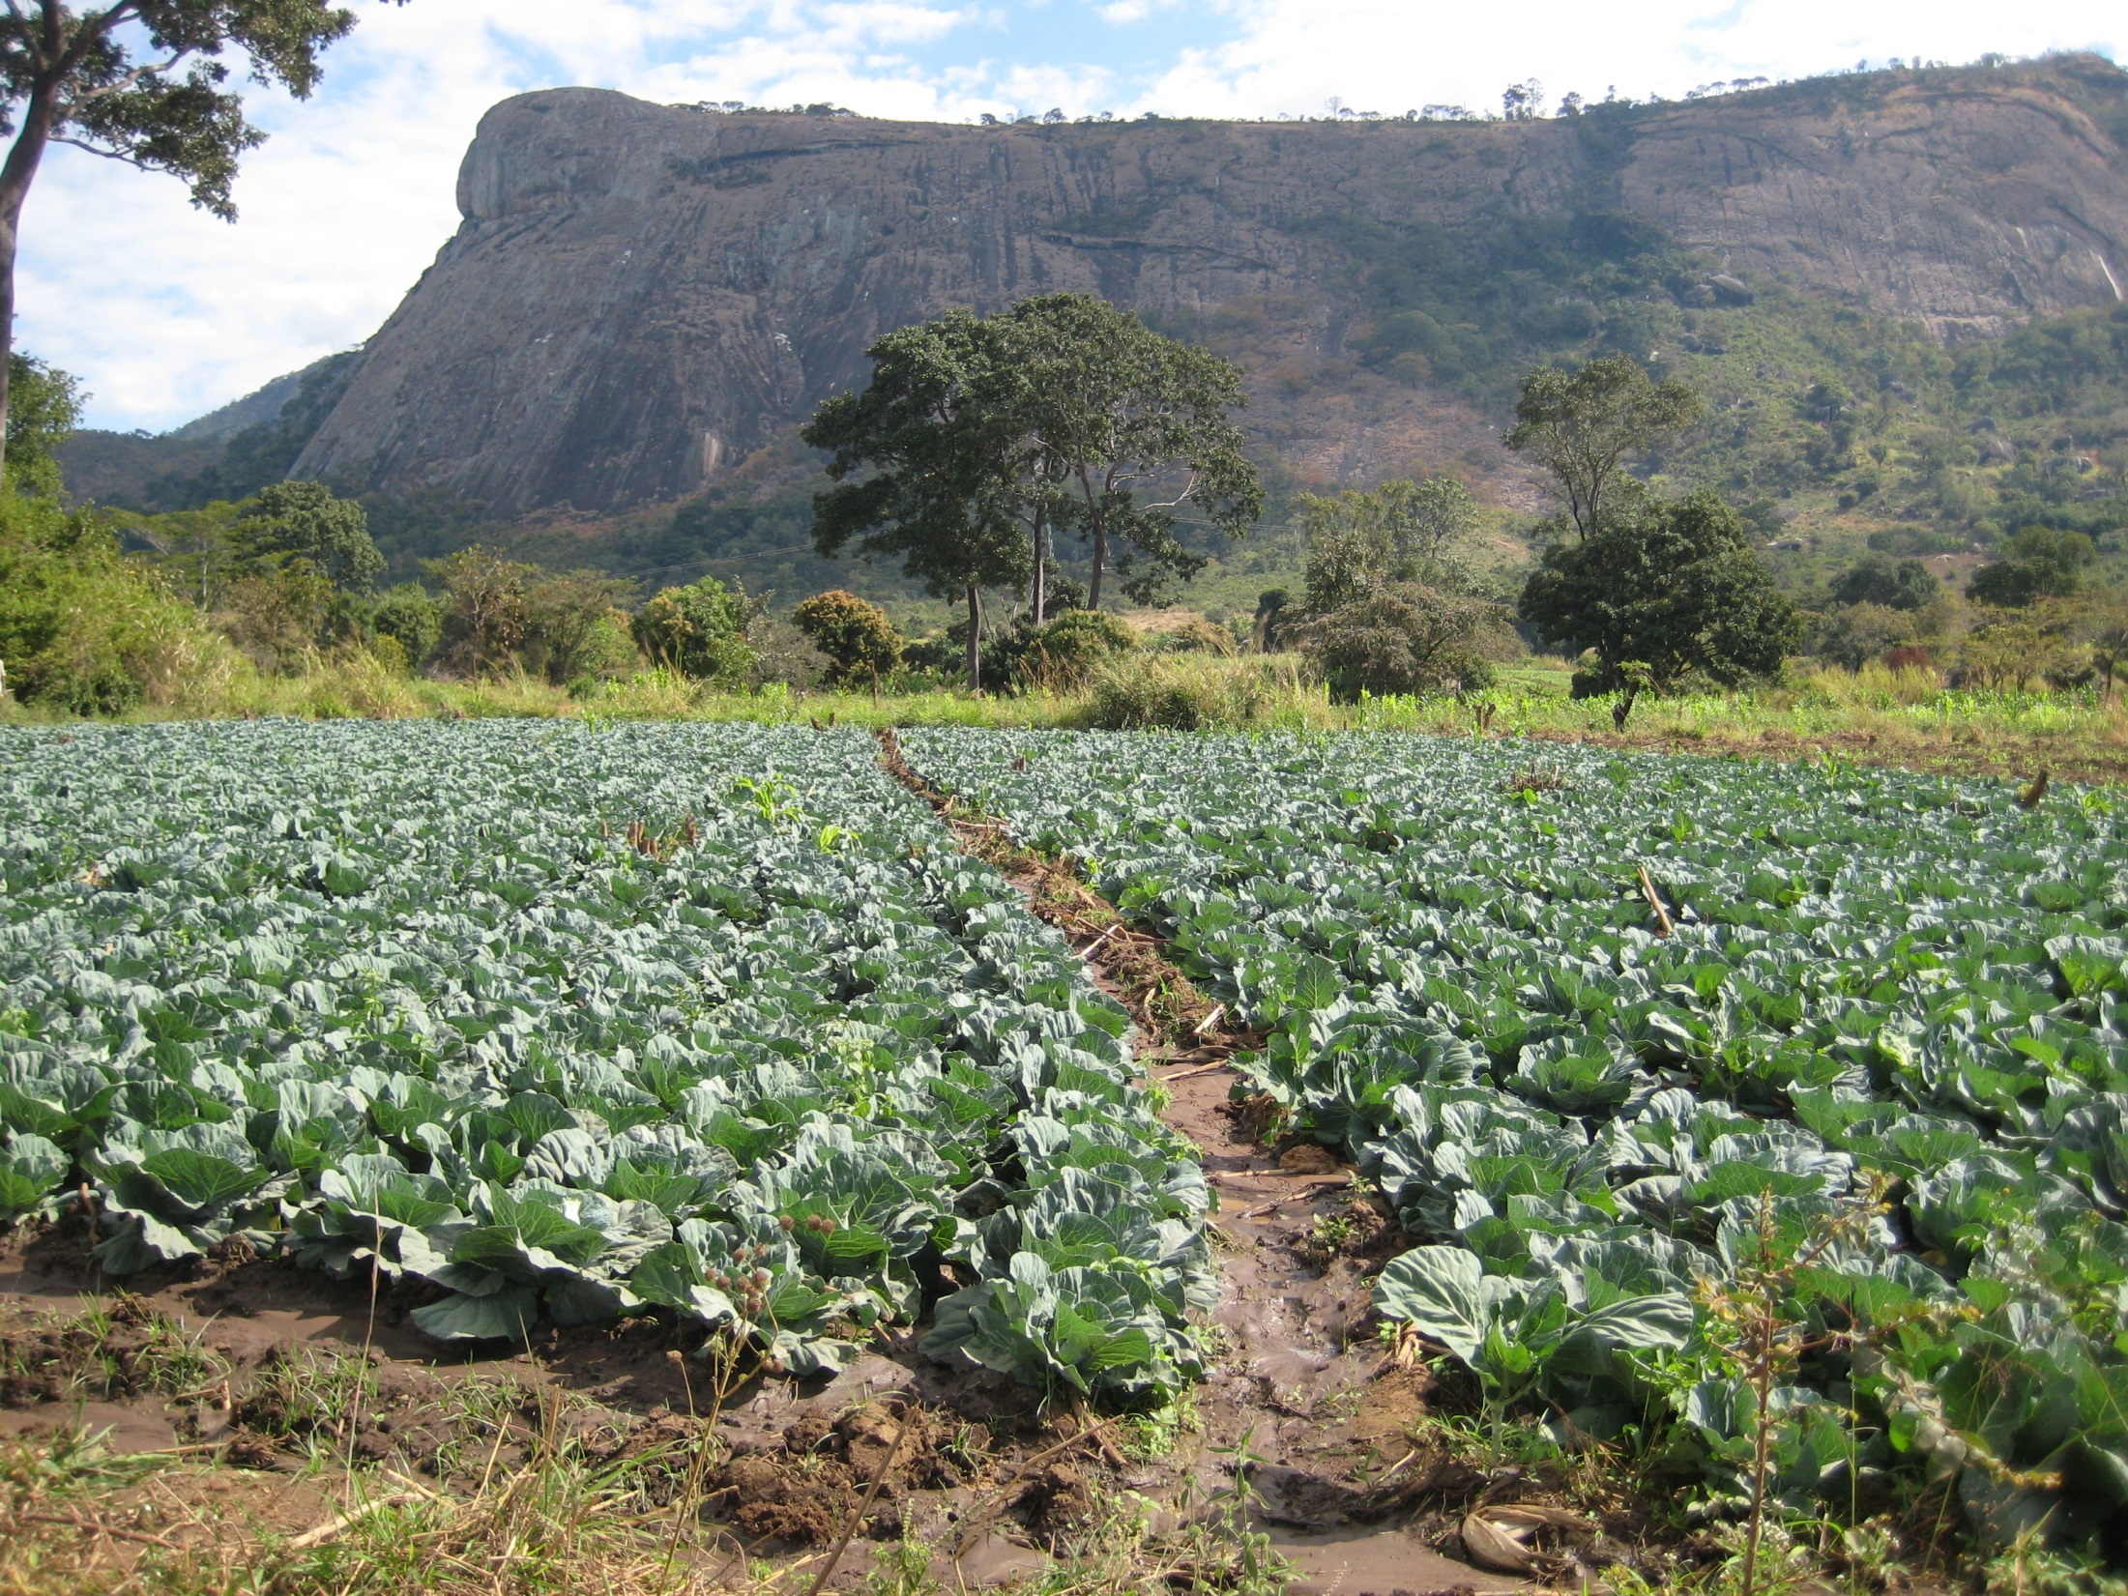

Slide 11
Field studies
Three-phase methodology:
  quick characterisation, using group and individual interviews and transect walks, and secondary data to identify extent, history, key people
  In-depth interviews to understand engagement by local and external actors
  Survey of irrigating and non-irrigating households
  9 sites in Tanzania, 9 sites in Mozambique
    Total sample 2733 households (1372 Mz, 1361 Tz):
    Sample adjusted to ensure minimum representation (irrigating vs non-irrigating) at each site: 996 non-irrigating, 1737 irrigating.

Slide 12
SAFI Tanzania sites
Case Study | Region | Irrigation methods | Main crops | external engagement
Iringa | Iringa | Gravity, stream diversion | rice | Some state improvement
Kahe | Kilimanjaro | Motor pump and borehole | Onions, tomatoes | none
Kilombero | Morogoro | Gravity, stream diversion | rice | Some state investment
Makanya | Kilimanjaro | Spate irrigation | Maize, beans | Somes tate investment
Mandanaka Mnono | Kilimanjaro | Gravity, stream diversion | rice | Some state investment
Mang’ola | Arusha | Gravity, stream diversion Some motor pumps | Maize, onions | Some state investment
Mapogoro | Mbeya | Gravity, stream diversion | rice | State –farmer consultation on design
Mijongweni | Kilimanjaro | Gravity, stream diversion | Rice, maize, beans | Some state investment
Rukwa | Rukwa | Gravity, stream diversion | rice | shutdown

Slide 13
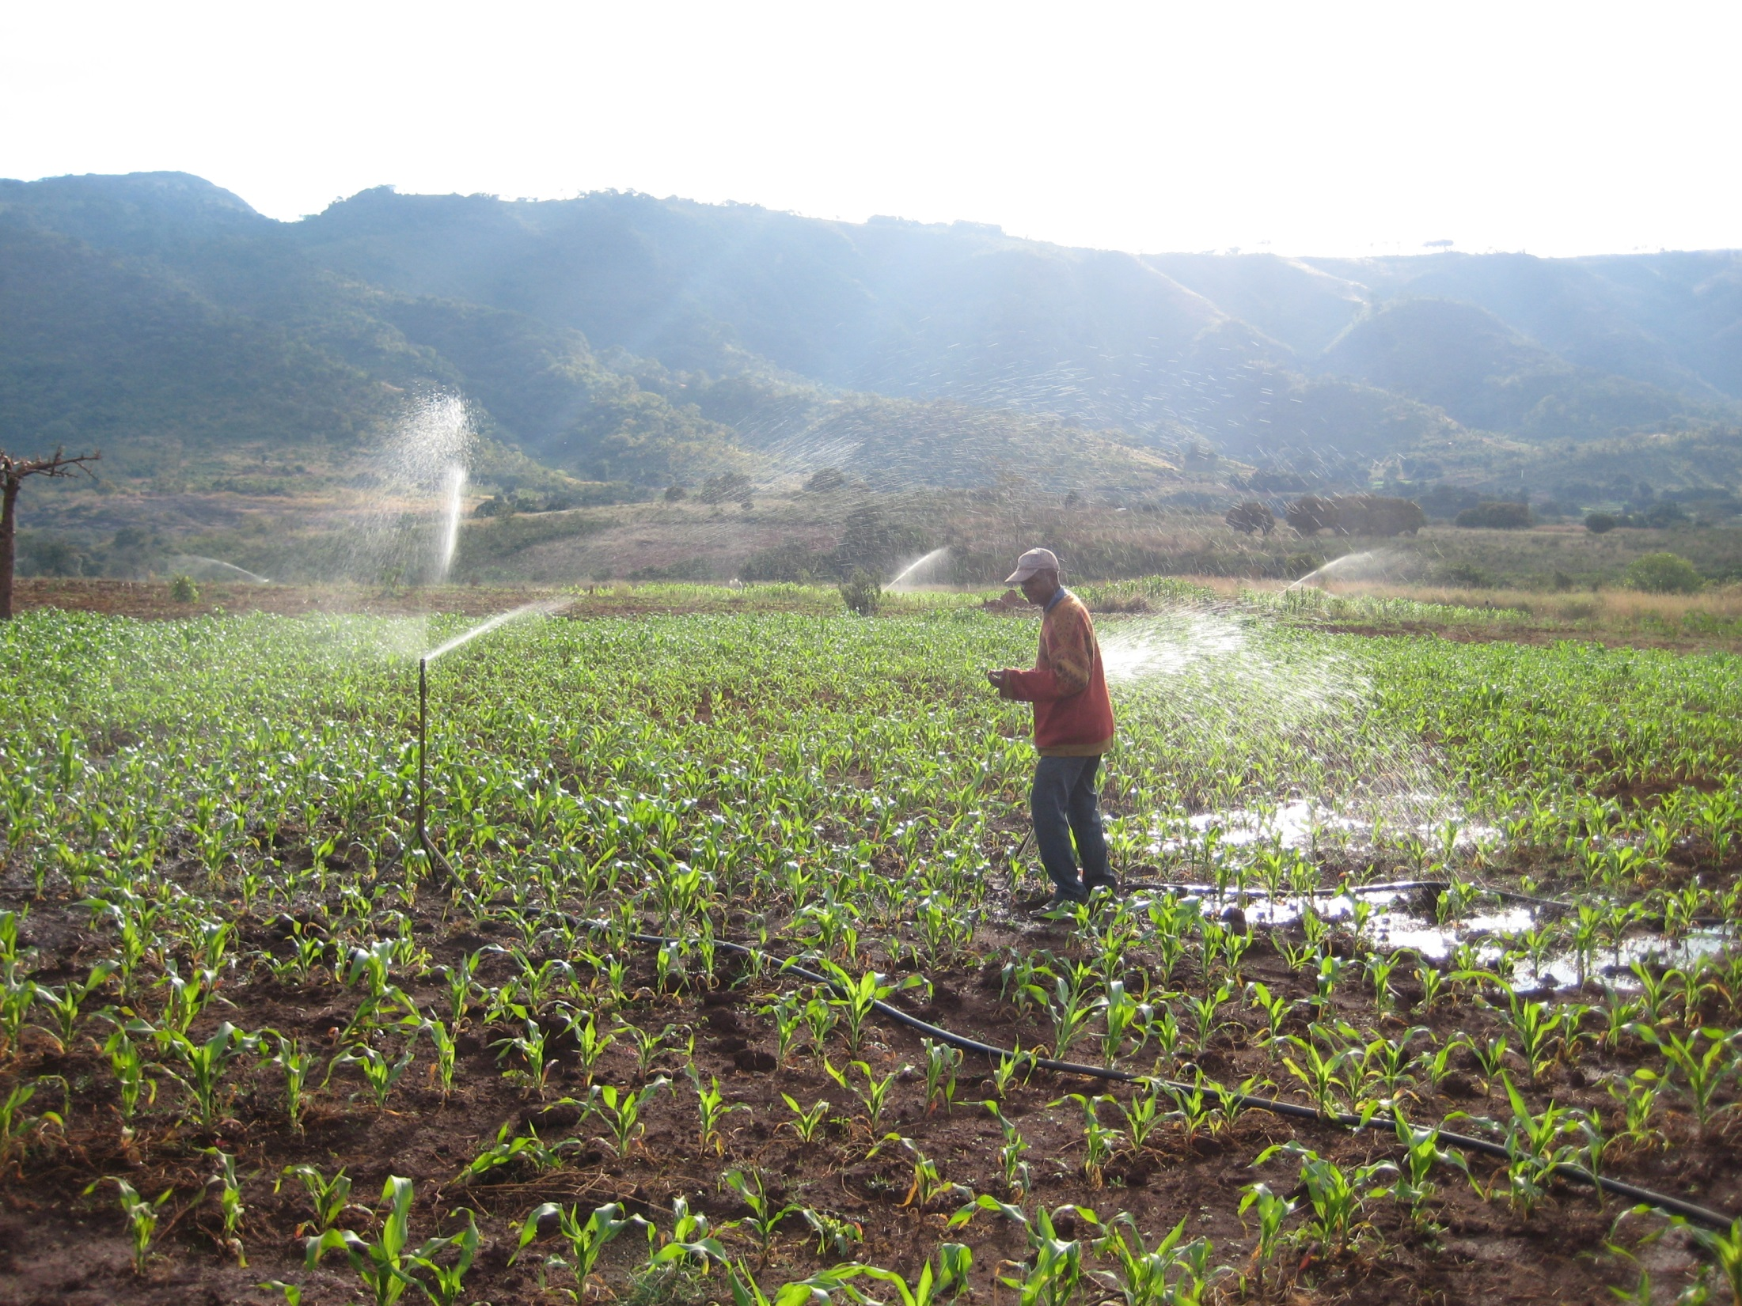

Slide 14
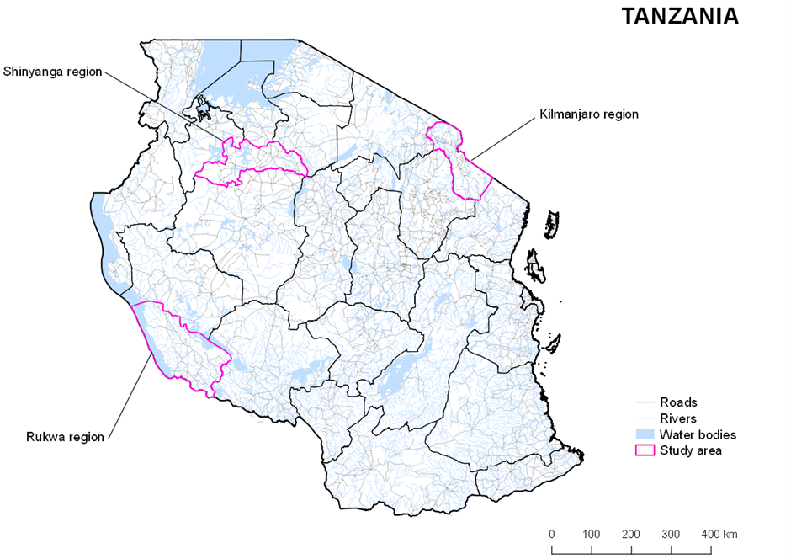
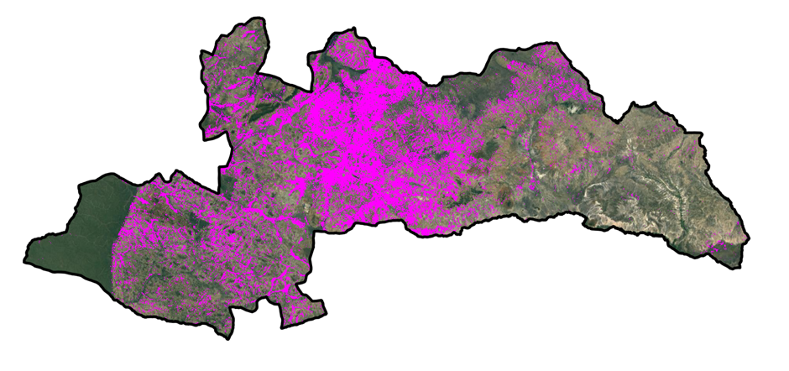
Pilot study of radar imaging using Sentinel-1 satellite data
(Bowers et al. forthcoming)
Distribution of irrigated areas predicted from radar reflection analysis in Shinyanga region.

Slide 15
How much irrigation in Tanzania?
Nationally:
  Areas with irrigation potential = 29.4 million ha, of which
  7.1 million are ‘medium’ or ‘high’ potential
  Current official irrigation= 0.46 million ha, increasing to 0.75 million by 2025.
In Shinyanga region, total area of irrigation:
AQUASTAT | FAO records based on government reports | 2,181
Agricultural census 2002-3 | (but 89% of paddy rice is ‘not irrigated’) | 10,266
Agricultural census 2007-8 | (but 94% of paddy rice is ‘not irrigated) | 29,783
Satellite radar reflection analysis | Depends on identifying characteristic change of image over time. | 267,000 (+/- 37,000)

Slide 16
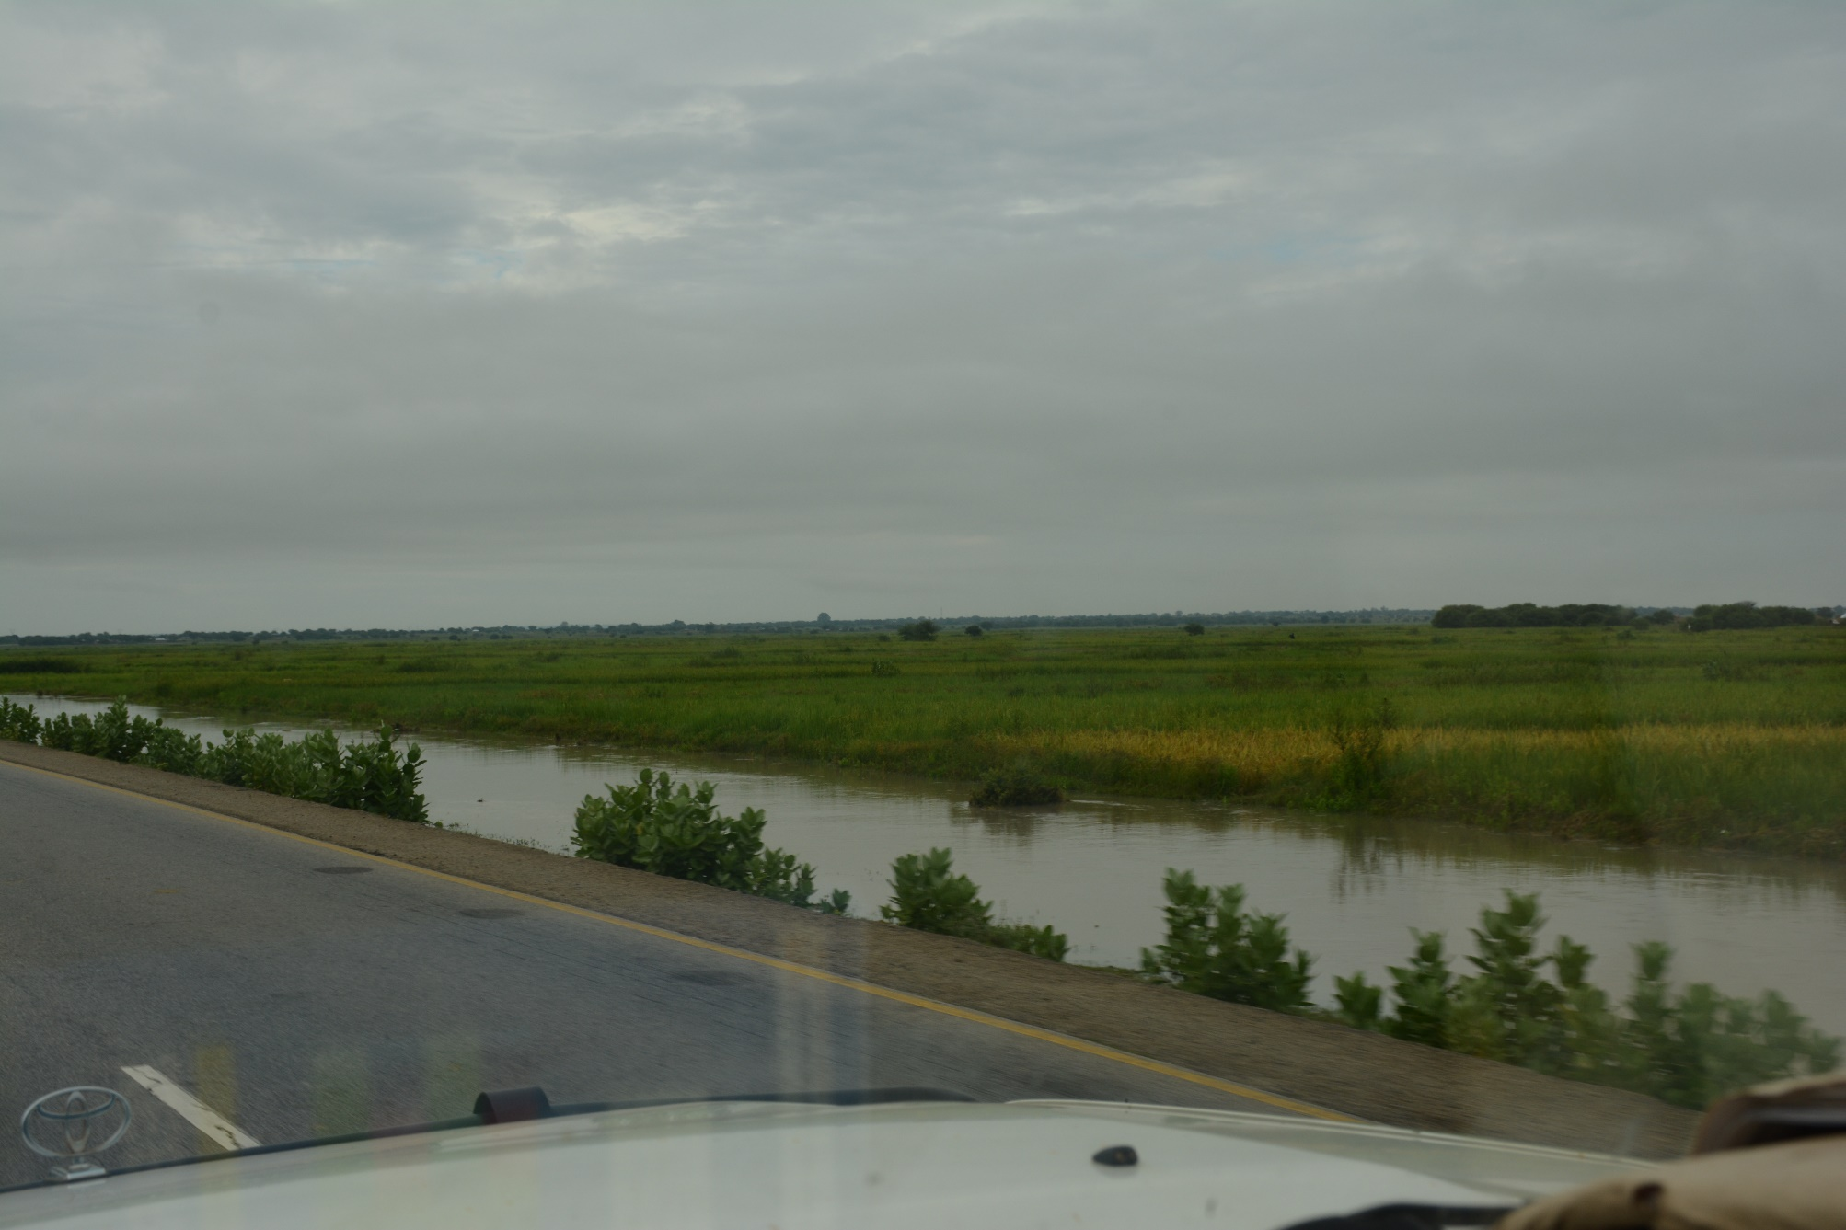
Missing irrigation? Shinyanga rice fields

Slide 17
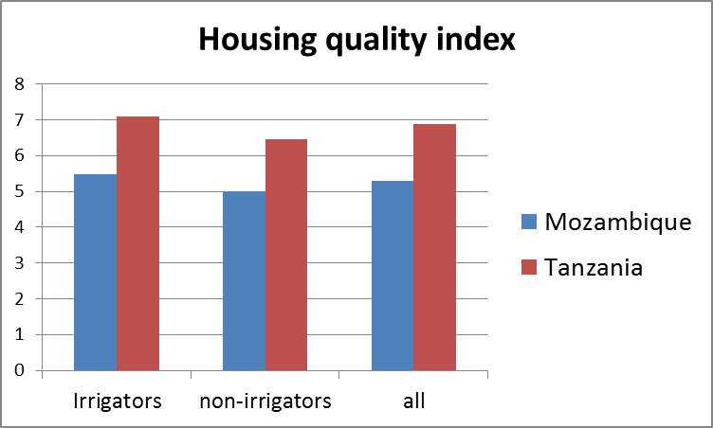
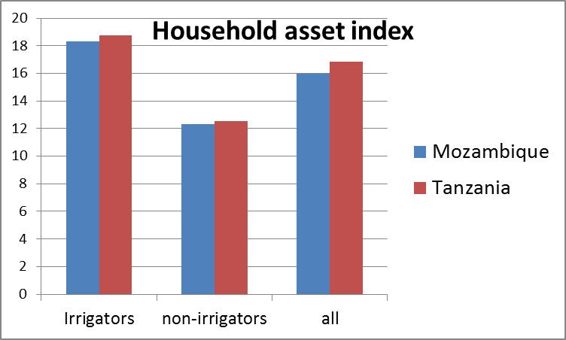
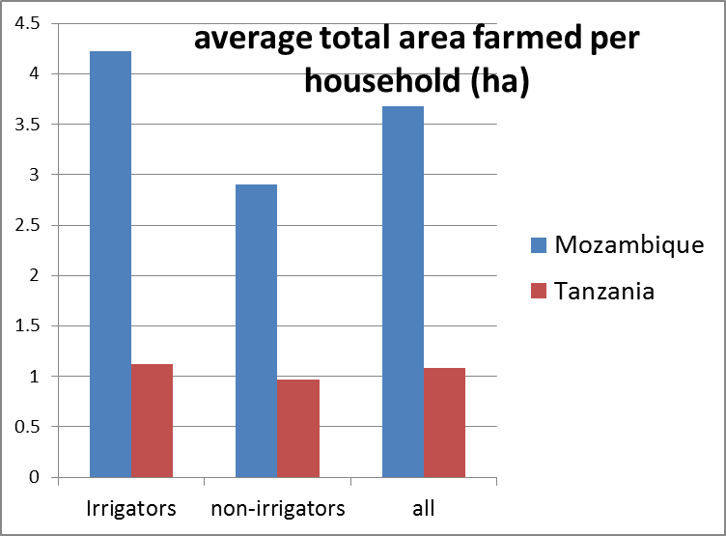
Preliminary findings: irrigators are wealthier than non-irrigators

Slide 18
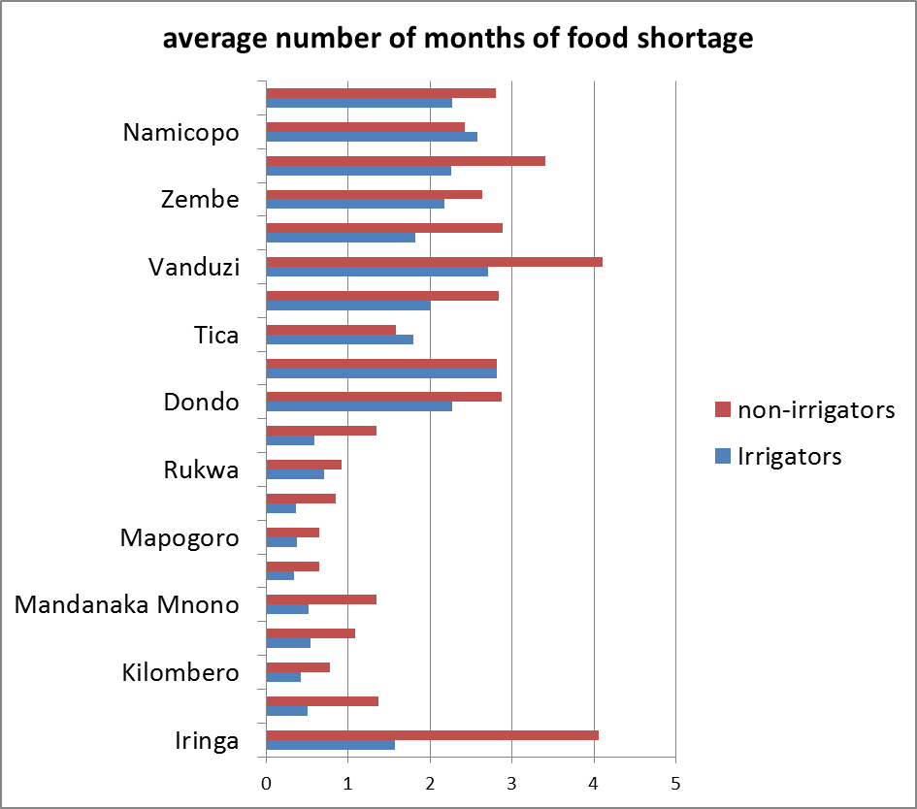
And have greater food security

Slide 19
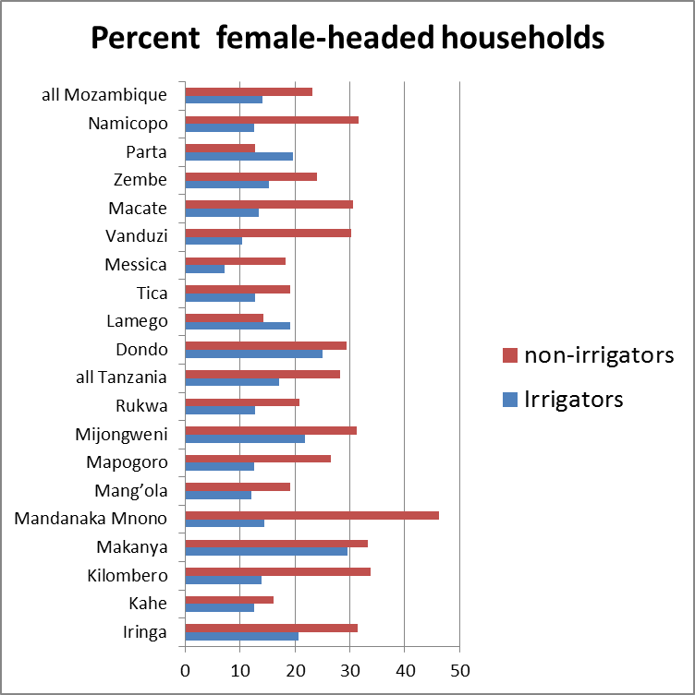
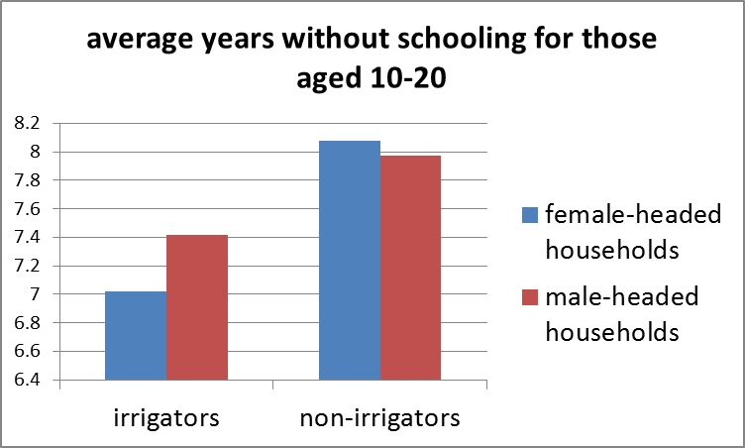
Preliminary findings: fewer female-headed households among irrigating than non-irrigating
Female-headed households also tend to be smaller and poorer
But their children may benefit more from irrigation

Slide 20
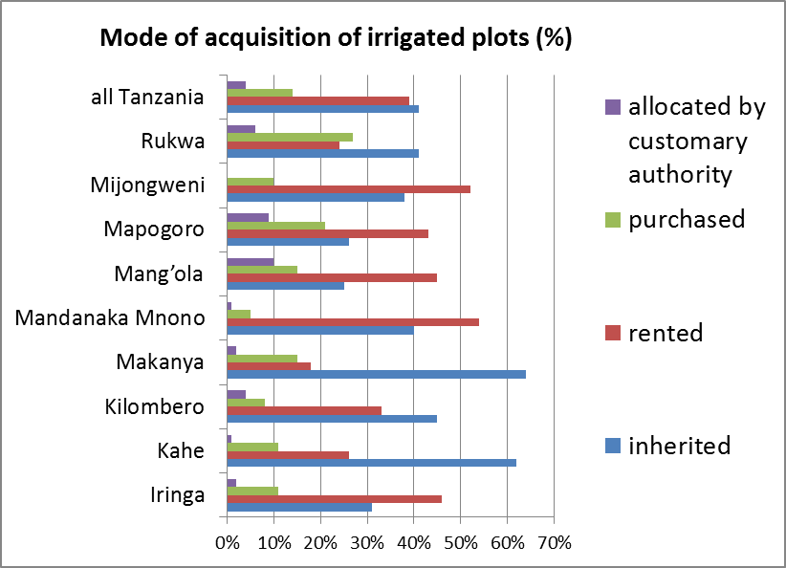
Market-based land acquisition of land for irrigation.

Slide 21
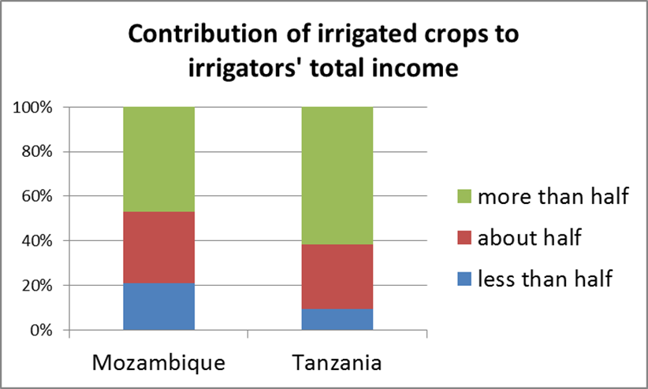
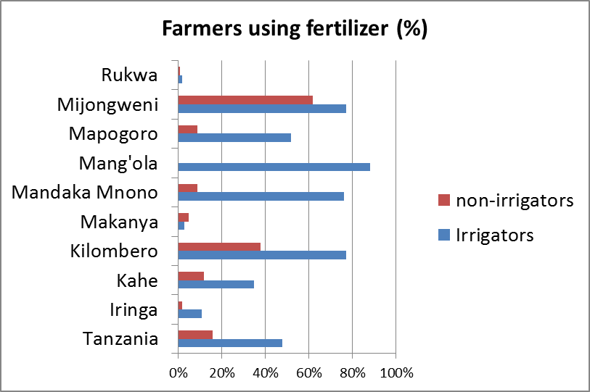
Farmer-led irrigation development is market-oriented and a principal source of income. Irrigators invest in inputs

Slide 22
Farmer-led irrigation development (FLID):
Key conclusions
Benefits
Raises productivity, incomes and employment
Cheaper for government than large-scale irrigation schemes
Greater use of farmers’ local knowledge
Risks
Increases water use (and competition?)
Accentuates existing social and economic inequality?
Increases pollution risk
Challenges to regulatory authorities

Slide 23
Actions and responses to farmer-led irrigation development
Integrate into economic and social security strategies
  Reduce vulnerability and spread benefits
  Facilitate access to reliable markets (inputs and outputs)
  Identify and remove constraints
Learn from existing practice (replicability issues?)
Get more accurate data
Develop a supportive and accessible regulatory framework:
  Recognise and register but avoid onerous procedure that stifle initiatives and dynamism
  What capacity deficits are there in regulatory agencies?

Slide 24








www.safi-research.org
Notes:
DFID-ESRC funded
Started in January

